Slide 1
Listening Session
Consolidated Plan & Fair Housing Plan
2025-2029

Slide 2
Why are we here today?
The feedback from conversations with our community partners about housing in Maine will help inform two important initiatives:
2025–2029 Consolidated Plan for Housing and Community Development, which directs the uses of federal funding
Fair Housing Analysis, which identifies obstacles and impediments to equal access to housing opportunity

Slide 3
Consolidated Plan
What is the Con Plan?
A 5-year planning document required by HUD to help each state …
Identify affordable housing and community development needs and market conditions;
Establish specific goals
related to the needs and conditions; and
Develop priorities based on the needs and conditions.

Slide 4
What is the purpose of the Con Plan?
To increase:
Supply of Affordable Housing
Homeownership opportunity
Housing Rehabilitation
Housing and services to those experiencing or at risk of homelessness
Public services to low-and moderate- income households and persons with special needs
To provide:
To improve:
Public infrastructure
Planning and Administration
Fair Housing

Slide 5
Funds allocated through the Con Plan?
Fund | Administrator | Total 2024 Allocation
Community Development Block Grant (CDBG) | Maine Department of Community Development (DECD) | $9,800,000
Emergency Solutions Grant Program (ESG) | MaineHousing | $1,287,417
HOME Investment Partnership Program (HOME) | MaineHousing | $3,503,849
Housing Trust Fund (HTF) | MaineHousing | $2,830,350

Slide 6
Housing Availability and Affordability
The income needed to support the median home price is at least 20% greater than the median income in every county in Maine.
Notes:
Housing availability has decreased in Maine, causing home prices and rents to increase

Slide 7
Maine’s Population Trend
Notes:
Until 2019, Maine’s population remained very stable (around 1.33 million).
The population has grown relatively fast, but unevenly, since then.

Slide 8
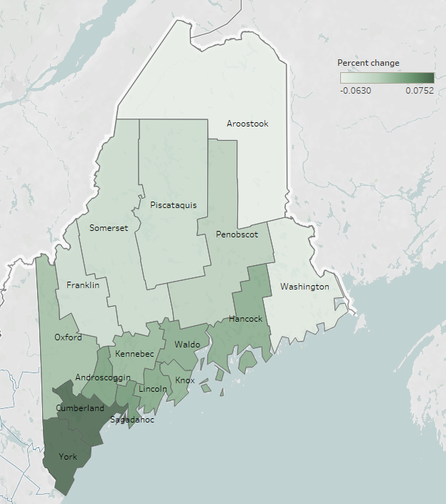
County population change
Whereas the state population increased by 2.8%, some rural counties decreased by as much as 6.3% and southern counties increased by as much as 7.5%.

Slide 9
Homelessness in Maine – 2024 Point in Time
People in Shelters and Unsheltered

Slide 10
Fund details:
Homeless Funds (ESG/HOME)
Eligibility:
Nonprofit corporation, member of local Homeless Service Hub
Eligible Uses of Funds:
Emergency Shelter Operation (maintenance, repairs, rent, security, fuel, equipment, insurance, utilities, food, furnishings, supplies and staff)
Rapid Re-Housing Stabilization Services (ESHAP)
Tenant-based rental assistance (STEP)
Restrictions:
Coordinated Entry and HMIS participation requirements

Slide 11
2024 Homeless Funds allocations (ESG/HOME)
Amount | Funding source | Use | Goal
$643,708 | ESG | Emergency Overnight Shelter | 5,000 people assisted
$643,709 | ESG | Rapid Re-Housing Stabilization Services (ESHAP) | 3,500 total households assisted
$1,400,000 | HOME | Tenant-based rental assistance (STEP)

Slide 12
Fund details:
Development Funds (HOME/HTF)
Eligibility:
Qualified developers
Eligible Uses of Funds:
Multifamily Housing Development (including construction, acquisition, soft costs)
Restrictions:
HOME:
50-60% AMI affordability (depending on number of units)
HTF:
30% AMI affordability
Two-year deadline to commit and spend funds
Usually paired with special needs vouchers and set asides

Slide 13
2024 Development Funds allocations (HOME/HTF)
Amount | Funding source | Use | Goal
$2,103,849 | HOME | Multifamily Housing Development under Rental Loan Program | 95 rental units constructed 10 rental units rehabilitated
$2,830,350 | HTF

Slide 14
Con Plan - Discussion Questions
1. Which do you think are Maine’s most critical housing needs?
Increase supply of Affordable Housing
Increase Homeownership
Housing Rehabilitation
Preservation of Affordable Housing
Rental Assistance
2. What are the greatest barriers to increased housing production?
3. What supports, resources, policy changes or practices are most needed to address homelessness?

Slide 15
What is Affirmatively Furthering Fair Housing (AFFH) ?
Agencies administering HUD
programs must certify that they will, as participants, act to:
Address significant disparities in housing needs and in access to opportunity;
Replace segregated living patterns with truly integrated and balanced living patterns; and
Foster and maintain compliance with civil rights and fair housing laws.
HUD requires participating agencies to perform “Fair Housing Analysis of Impediments” identifying housing opportunity barriers.

Slide 16
Fair Housing Analysis - process
1. Steps:
Identify fair housing issues
Develop a plan to address them, including goals to eliminate discrimination, segregation and disparities
2. Required considerations:
Housing laws, regulations, and policies
Availability of affordable, accessible housing in a range of unit sizes
Housing opportunity restrictions based on race, color, age, religion, sex, sexual orientation, disability, familial status, ancestry or national origin (Maine identified protected classes)

Slide 17
Fair Housing Data – Disability, by Age
In Maine 15.8% of individuals have one or more disabilities.
42% of Fair Housing complaints received by the Maine Human Rights Commission regard disability discrimination.

Slide 18
Fair Housing Analysis - Impediments Identified in 2019
Lack of Affordable Housing
Racial, ethnic and cultural barriers
Planning/zoning decisions that impede housing access for disabled individuals
Lack of availability and access to housing for disabled individuals
Limited access to neighborhood opportunities and community assets
Lack of understanding of fair housing and affirmatively furthering fair housing

Slide 19
Fair Housing Analysis - MaineHousing Actions 2020-2024
Increased affordable housing development and preservation
Increased homebuyer affordability (lower interest rate, down payment assistance, and education components)
Cultural outreach for program participation
Distribution of data, programs and affordable housing information
Landlord incentivization for Housing Choice Voucher Program participation
Implementing Fair Housing education and trainings

Slide 20
Fair Housing Analysis - Discussion Questions
1. What populations do you think have the highest need for housing in Maine?
Older Adults
Chronically Homeless
Persons with Disabilities
Minorities
Non-citizens
Larger families (5 or more persons)
Very low income (under 30% AMI)
Low to moderate income (51%-80%)
2. What are the impediments you see to Fair Housing?

Slide 21
Con Plan and Fair Housing Analysis Next Steps
Listening Sessions
June 11, 2024 through August 10, 2024
Public Hearing
August 8, 2024
Plan Drafting
August 13, 2024 – October 12, 2024
30 Day Comment Period
October 2024
Public Hearing on Draft Plans
November 2024
Submission to HUD
After 2025 Allocations announcement

Slide 22
Written Comments
Maine State Housing Authority
Attn: Compliance Officer II
26 Edison Drive
Augusta, ME 04330-6046
207-626-4600, 1-800-452-4668 Maine Relay 711
PublicComment@MaineHousing.org
Department of Economic and Community Development
Attn: Director, Office of Community Development
DECD
111 Sewall Street
Augusta, ME 04333
207-624-9817

